Slide 1

TOURS
An online ticket booking system for historical, iconic and pilgrimage places in India
Submitted by
Pritam sarkar, Bishal Ghosh
Under the guidance of
Dr. Soumya Sen
Assistant professor
A.K.Choudhury School of IT
University of Calcutta

Slide 2




PROBLEM STATEMENT
Background: An e-ticket (electronic ticket) is a paperless electronic document used for ticketing. It can help in better crowd management of museums/heritage sites. In addition, the prediction of the expected crowd should be added as a feature. Objective? It reduces booking expenses by eliminating the need for printing and mailing paper documents? Can help in keeping a better record of visitors? Can improve sales as a visitor can book, purchase and print out the electronic ticket any time 24 hours a day?

Slide 3


PROPOSED SOLUTION
Online Ticketing and Reservation: Implement a user-friendly e-ticketing platform that allows visitors to purchase tickets and reserve time slots online.
Real-Time Crowd Information: Integrate crowd monitoring and tracking technologies at heritage and historical sites. Display real-time crowd updates on the website, including current visitor numbers, peak hours, and any ongoing events.
Interactive Destination Guides: Provide detailed and interactive guides for each site, offering historical background, architectural insights, and nearby attractions so that people get an idea about the place beforehand.
24/7 Ticket availability: A visitor can book, purchase and print out the electronic ticket any time 24 hours a day which will improve the sales and business profit.

Slide 4


INTRODUCTION
Welcome to TOURS, your gateway to exploring the rich heritage and historical wonders of the world while staying informed about crowd conditions. We are excited to present a seamless and user-friendly platform that empowers you to discover and experience iconic sites in a hassle-free manner.

Slide 5

Functional flow

Slide 6
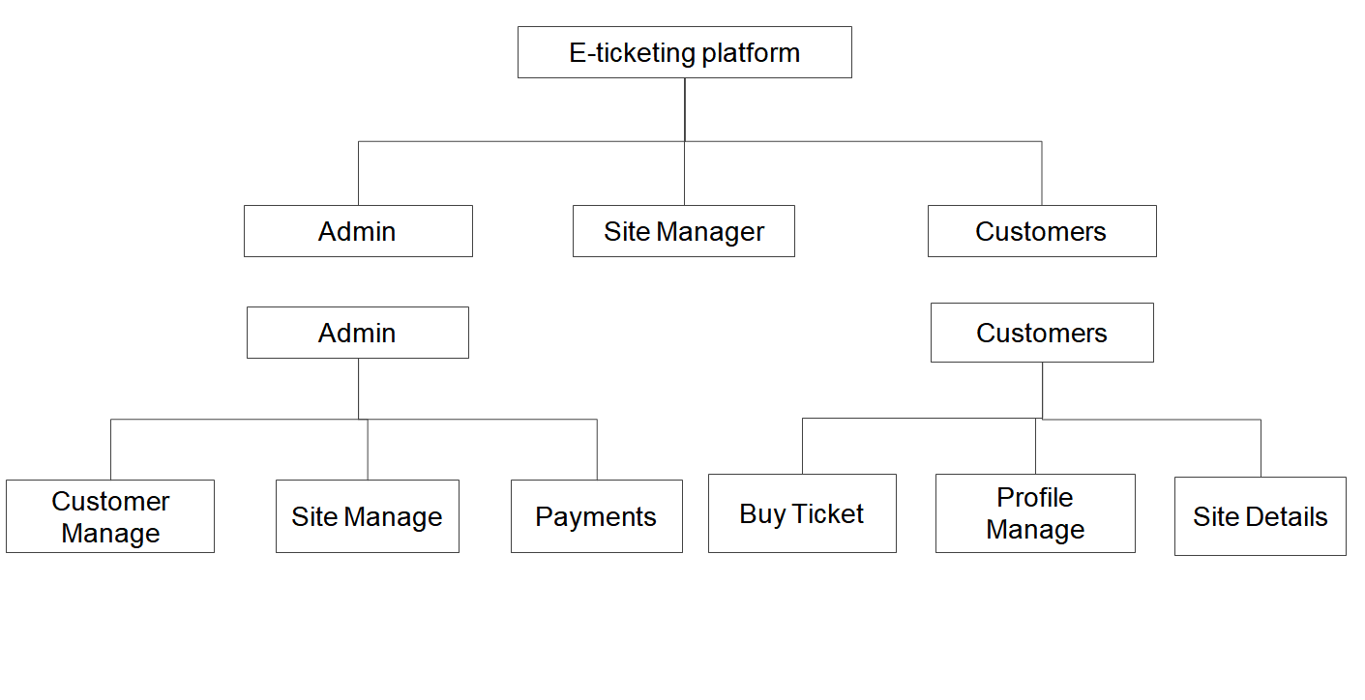
Tours
Functional Flow

Slide 7
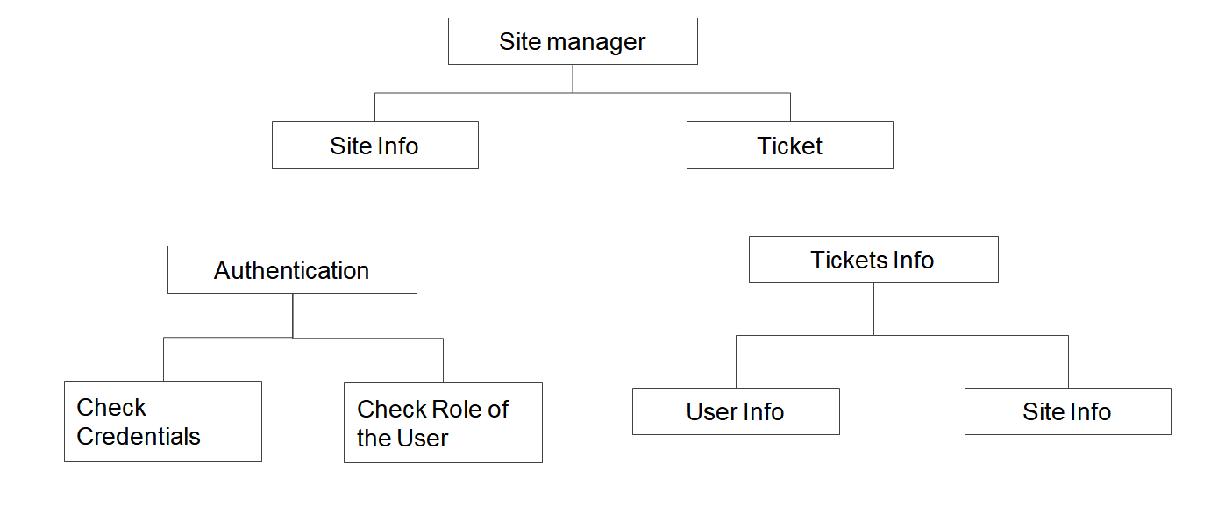
Functional Flow

Slide 8
OR-DIAGRAM

Slide 9
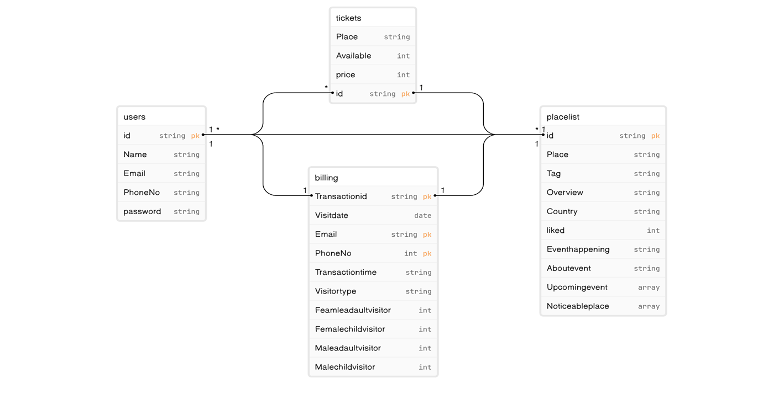
OR-Diagram

Slide 10
TECH STACK
Frontend
Backend
Database
Workspace(IDE)
React
NodeJS, ExpressJS
MongoDB
VS Code

Slide 11
CHALLENGES
E-ticketing systems involve multiple components, including user registration, payment processing, ticket generation, real-time updates, and more. Managing and integrating these components can be complex and time-consuming.
Implementing real-time crowd updates and ensuring that the information is accurate and up-to-date can be challenging

Slide 12
WEBSITE OVERVIEW

Slide 13
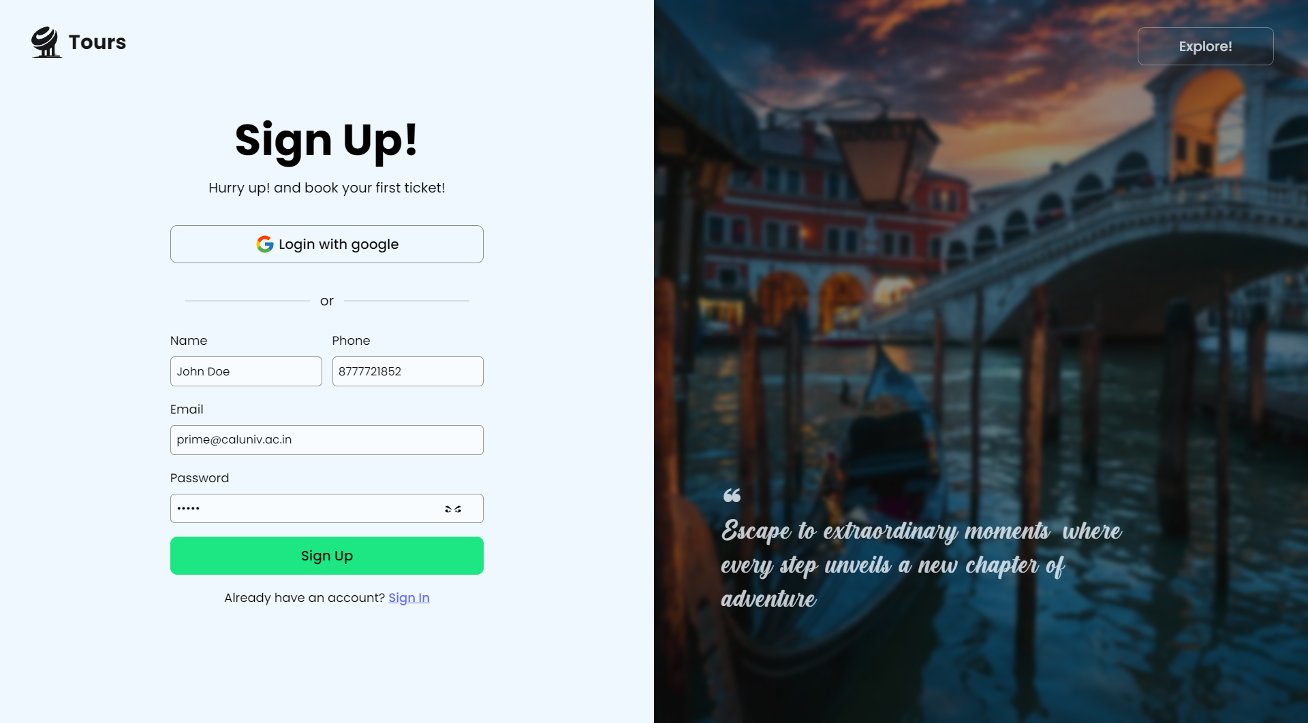
Sign Up Page

Slide 14
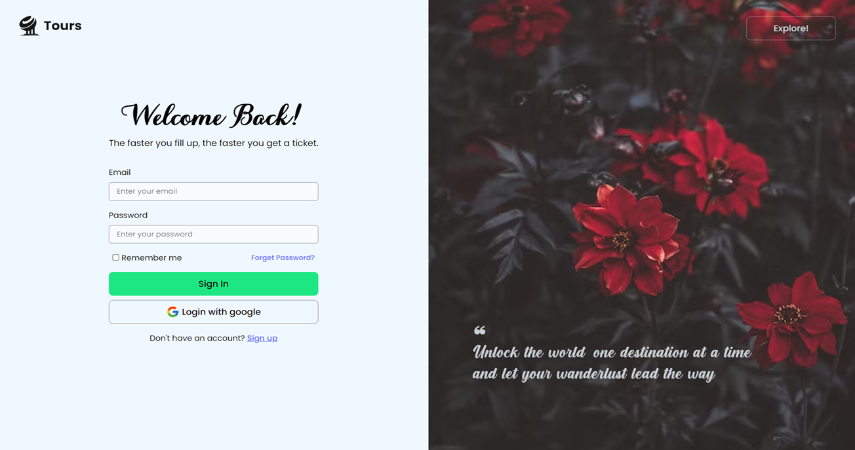
Login Page

Slide 15
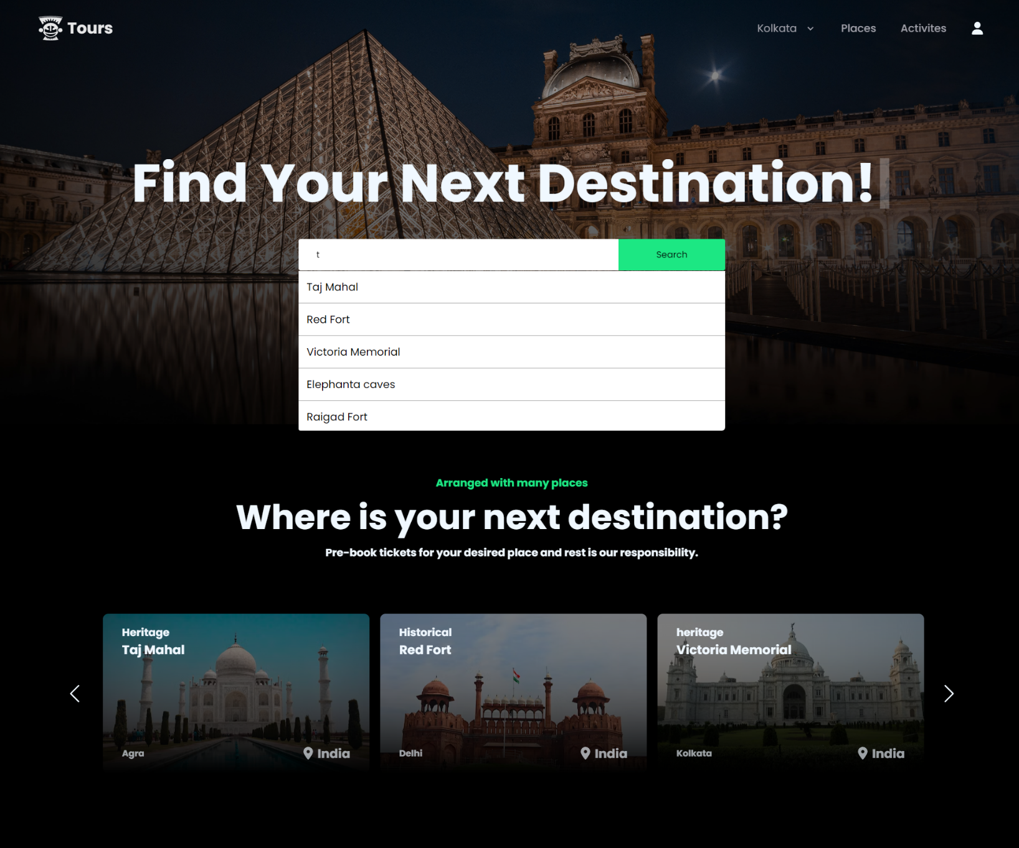
Home Page

Slide 16
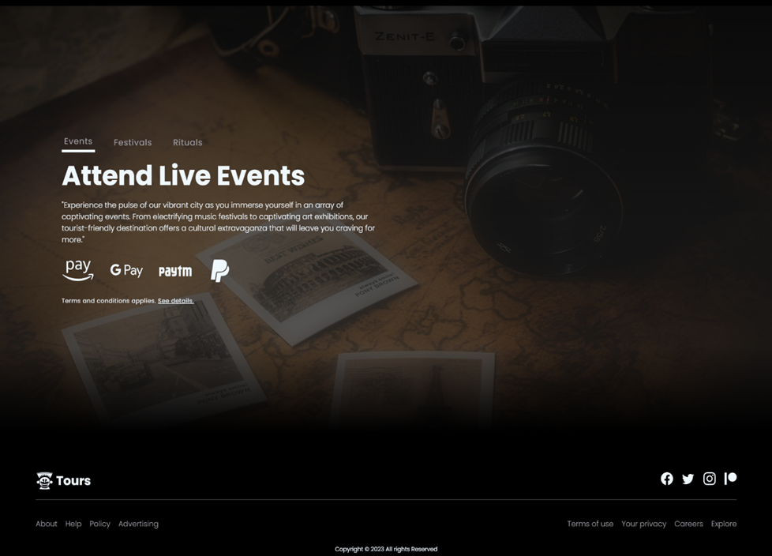
Home Page

Slide 17
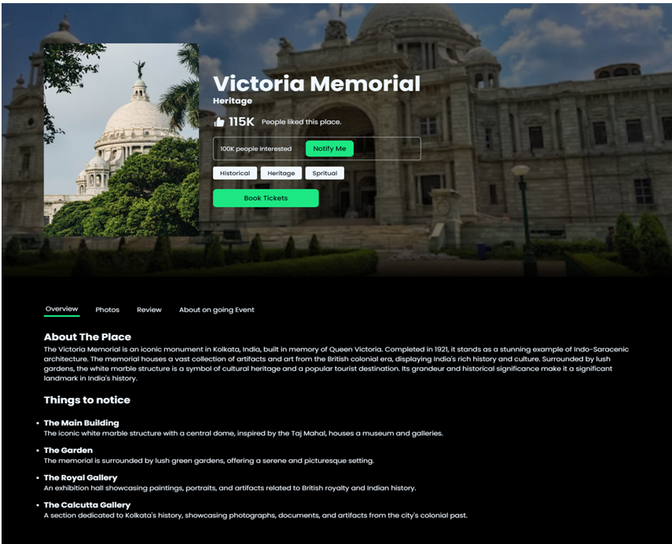
Place Details

Slide 18

Place Photos

Slide 19
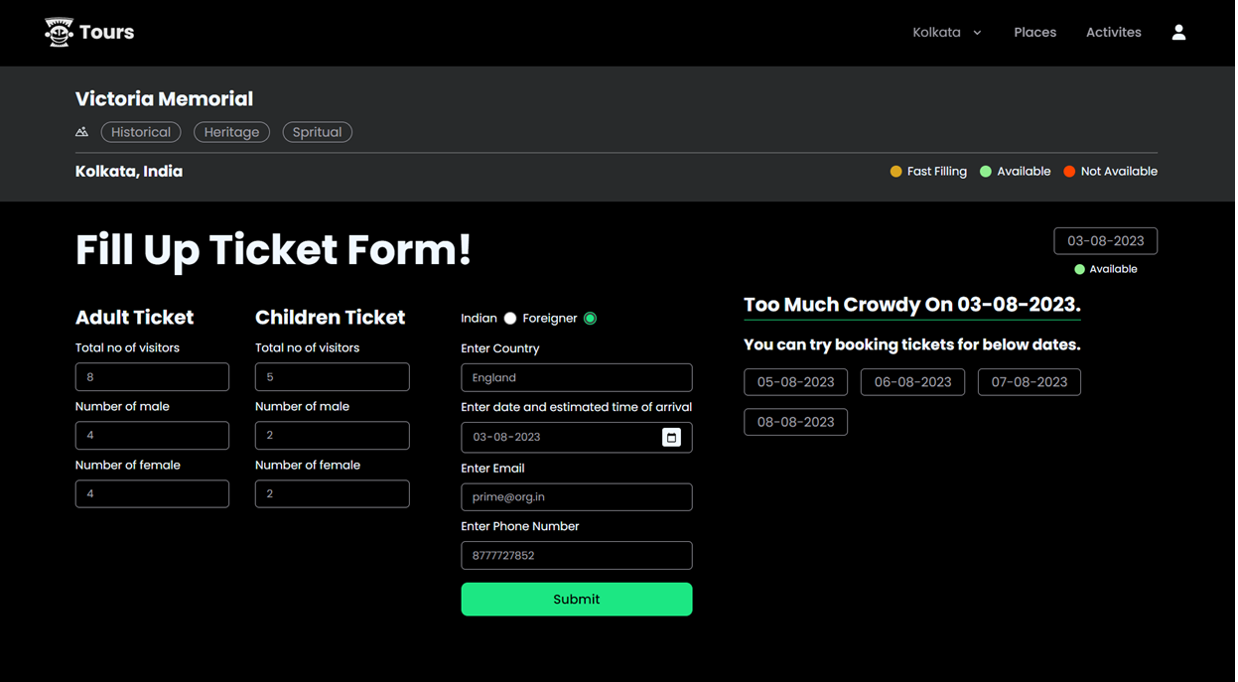
Ticket booking

Slide 20
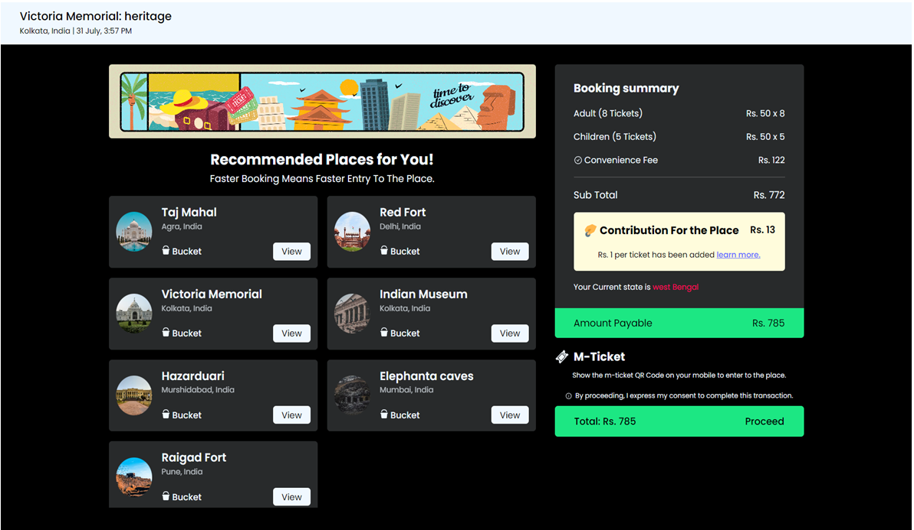
Summary of tickets

Slide 21
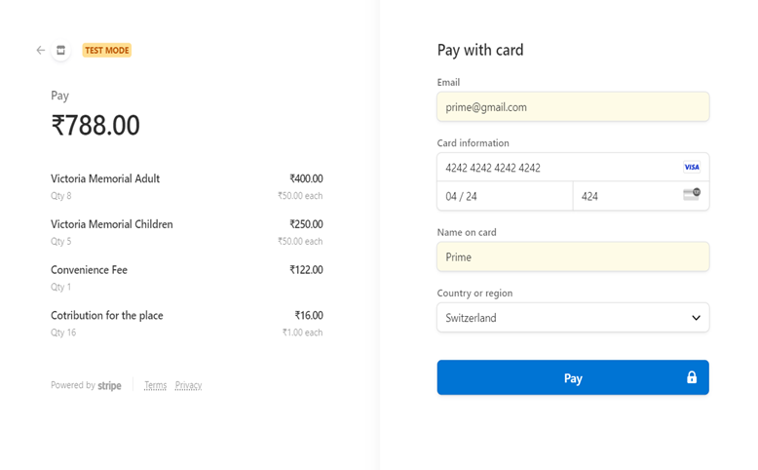
Checkout page

Slide 22
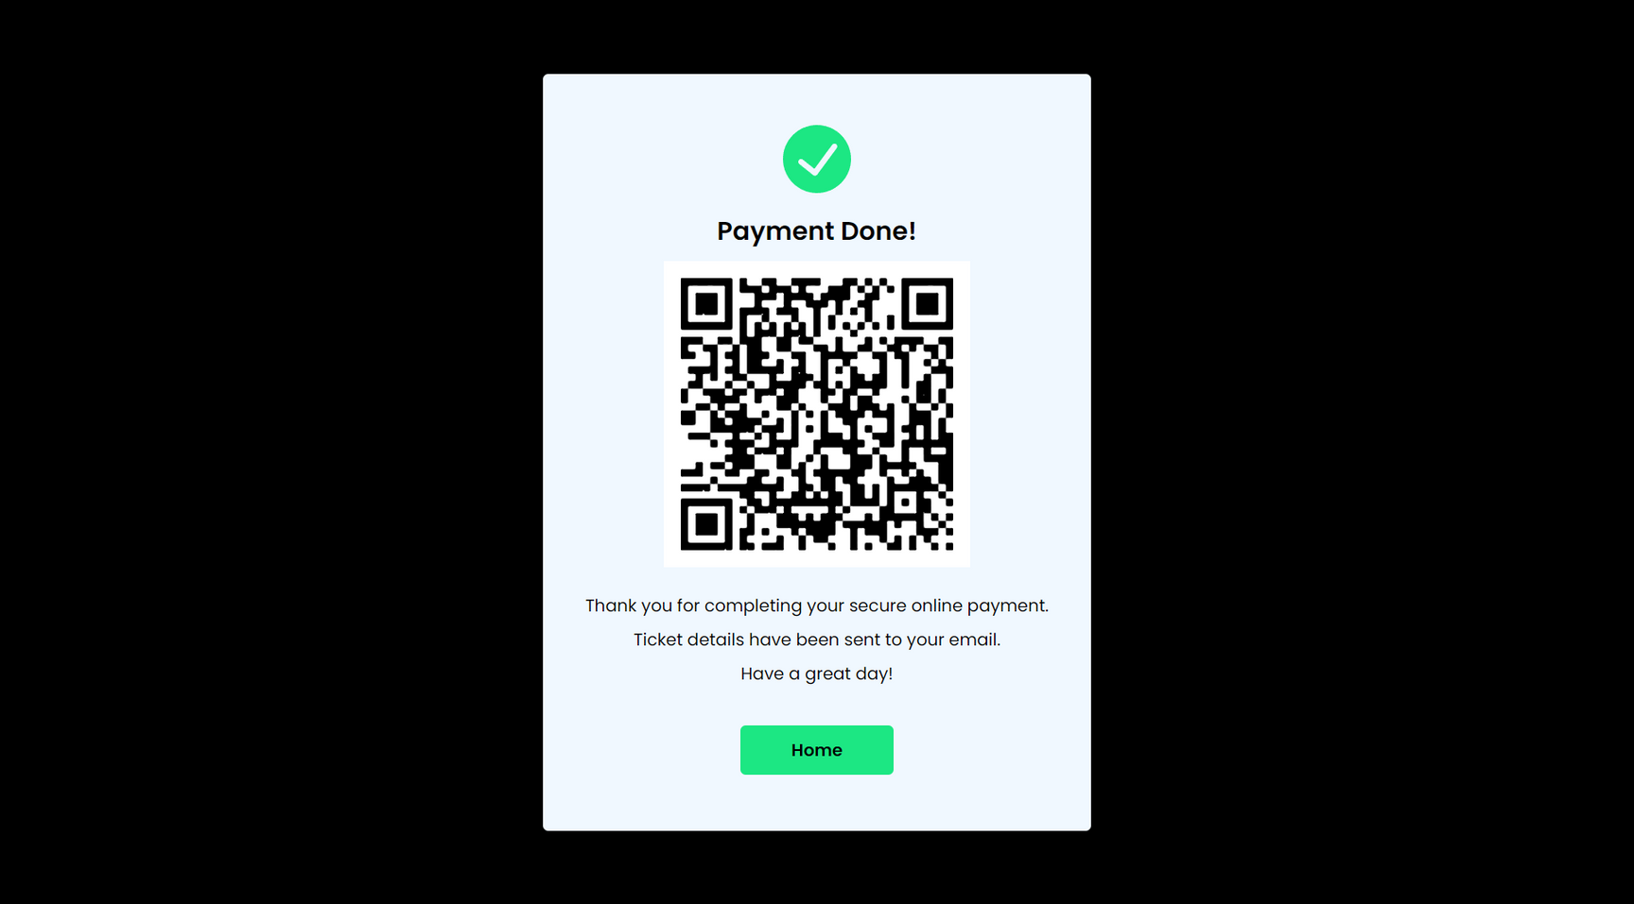
Payment success

Slide 23
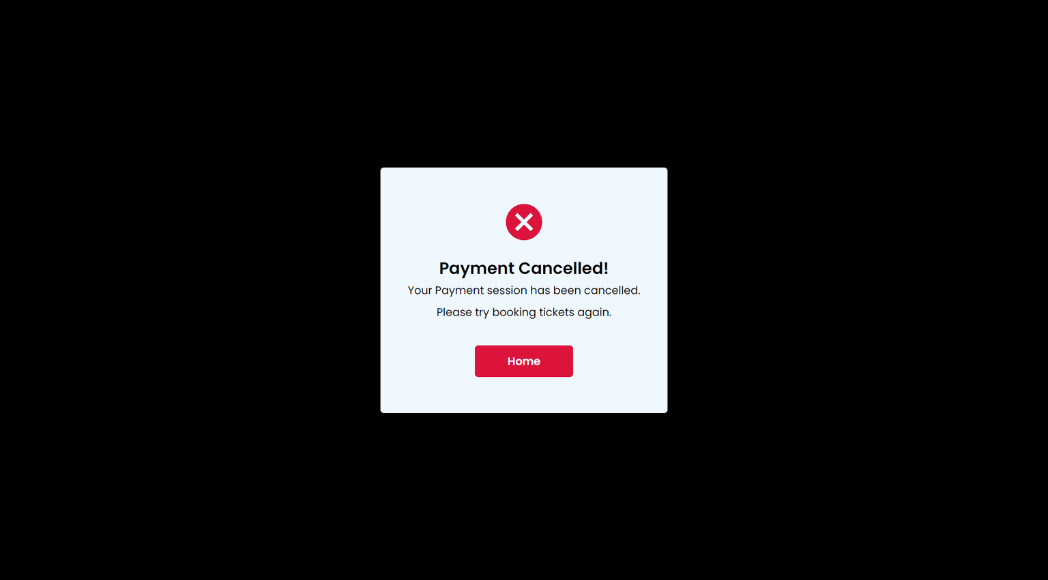
Payment success

Slide 24
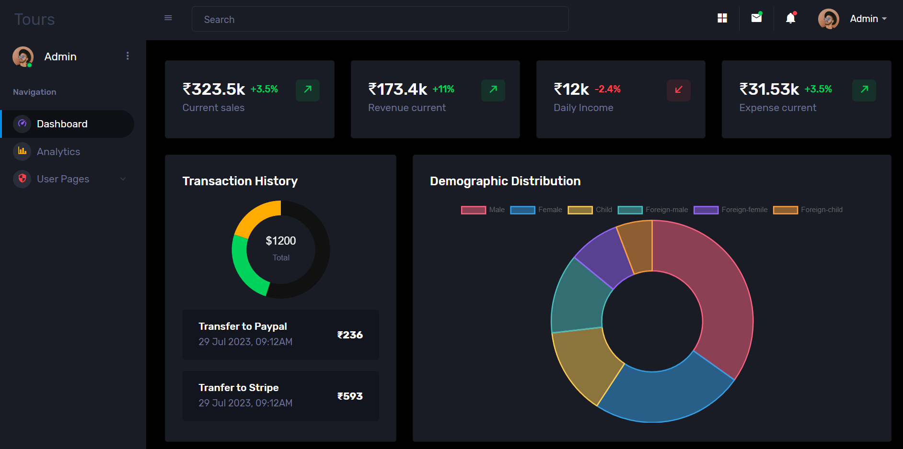
Admin Panel

Slide 25
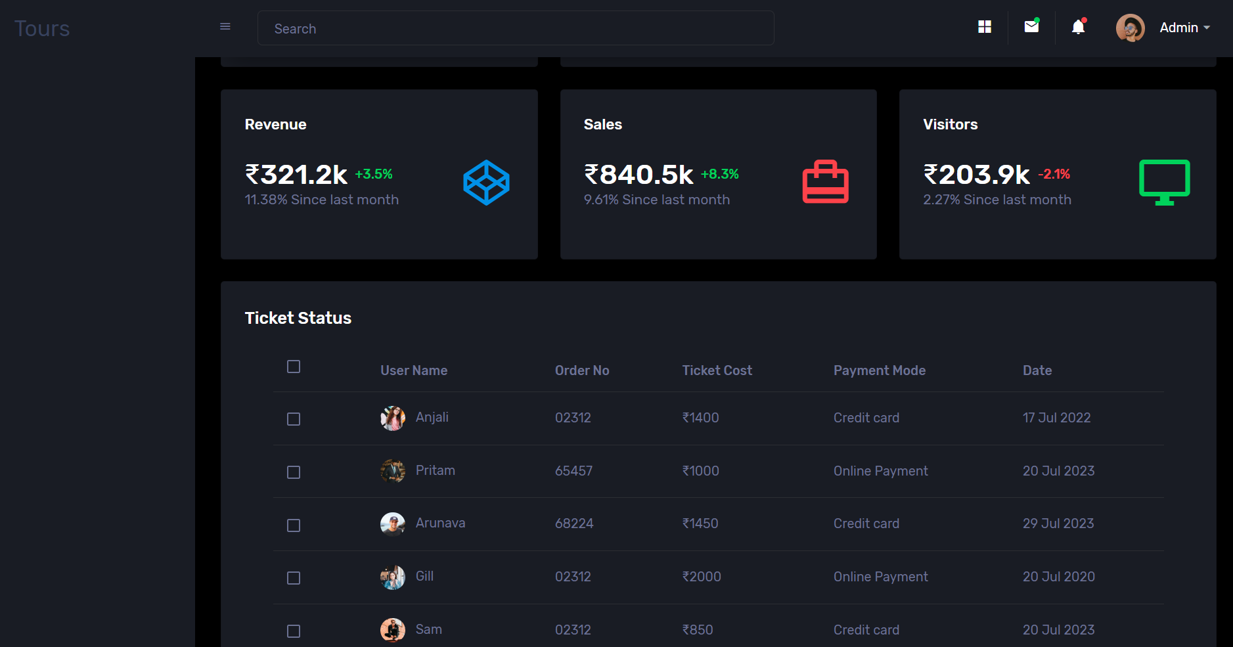
Bookings
Admin Panel

Slide 26
FUTURE SCOPE
➔Implementing AR and VR technologies can enhance the user experience by offering virtual tours, historical reconstructions, and interactive storytelling at heritage sites.
➔Expanding the platform to include information about historical and cultural events at these sites would attract more visitors during special occasions.
'
➔Developing advanced crowd management tools, such as predictive analytics and dynamic capacity planning, would optimize visitor flow and reduce congestion at popular heritage sites

Slide 27
CONCLUSION
By transitioning from traditional paper-based methods to electronic platforms, e-ticketing has streamlined the ticketing process, offering convenience, efficiency, and enhanced user experiences. With features like online purchasing, digital storage, and quick validation, the e-ticketing system has not only simplified ticket management for both users and organizers but has also significantly contributed to reducing paper waste and improving overall event logistics.

Slide 28

Thank you

